Slide 1

ONLINE INSURANCE MANAGEMENT SYSTEM

Slide 2


INTRODUCTION
This Online Insurance Web Application enables users to explore insurance services, check agent availability, and book appointments seamlessly.
The platform features user authentication with login and registration forms, along with validation for secure data entry.
Users can view available agents, request notifications for unavailable agents, and contact support directly through a contact form.
The interface is designed to be intuitive, using responsive styles and smooth transitions for an enhanced user experience.

Slide 3

PROJECT OVERVIEW
Customer Features :-
User Authentication
Appointment Booking and Cancellation
Appointment Management
Insurance Plan
Administration Features:-
Agent Management
Plan Information Management
Admin Dashboard

Slide 4

MILESTONES
1. User Authentication , Registration with Validation
2. Contact page , Agent Availability
3. Appointment Booking and Cancellation
4. Plan Information Management and Admin Dashboard

Slide 5
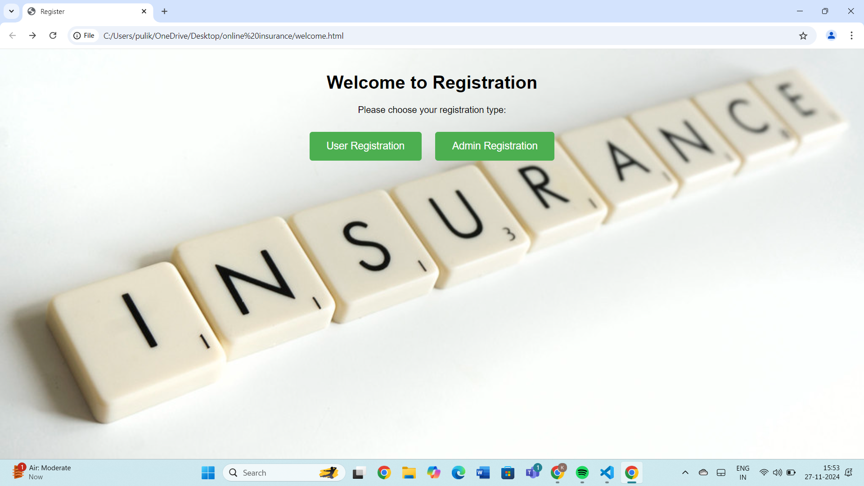
WELCOME PAGE
This is the welcome page.
Which shows user registration and admin registration

Slide 6
REGISTRATION PAGE
Registration page with strict validation,that age should between 18 to 100
Password must contain a capital letter,small letter,number and a special character

Slide 7
If we gave 3456 as passwords it shows.
If we gave 15 as age.

Slide 8
LOGIN PAGE
Login page:user can login in by providing their username and password .
By clicking on login,it will display the home page

Slide 9
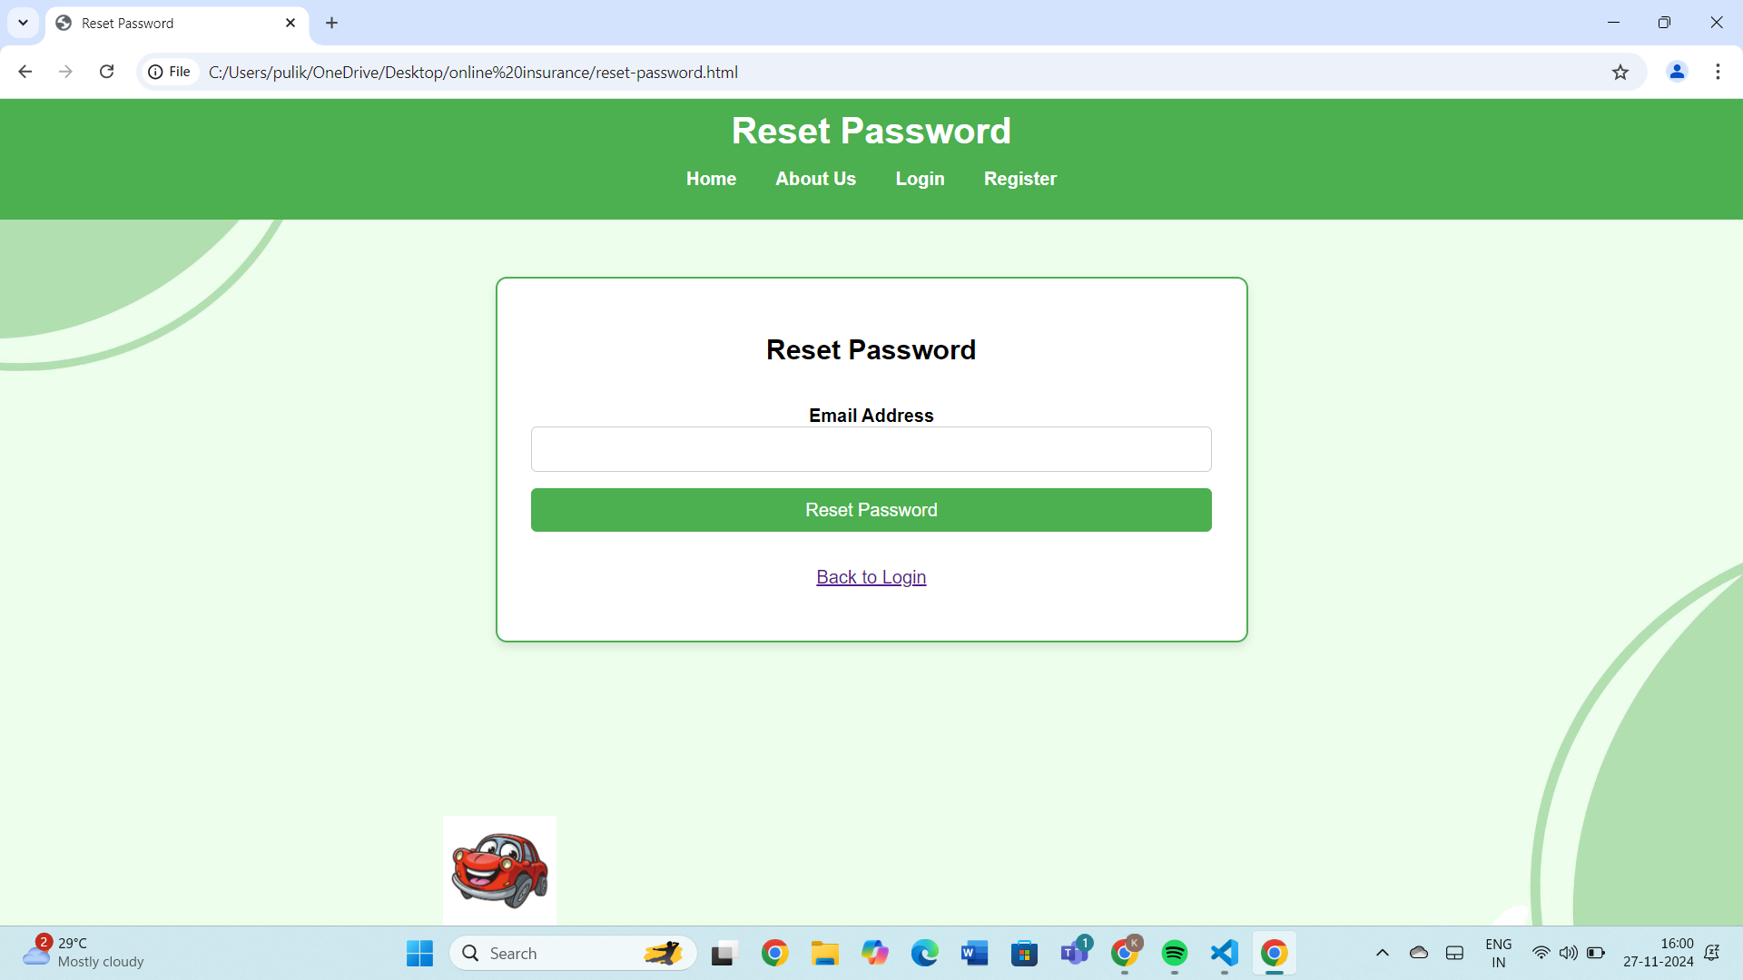
RESET PASSWORD PAGE
If user forget password they can reset it using their email id

Slide 10
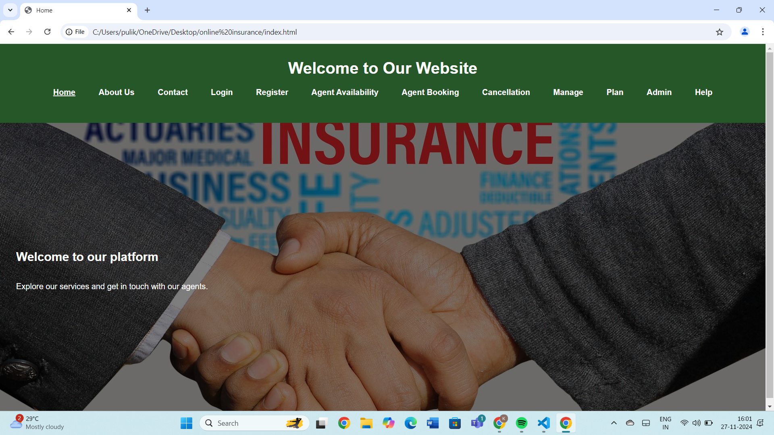
HOME PAGE
This is the Home page.
Which shows all the features of website.

Slide 11
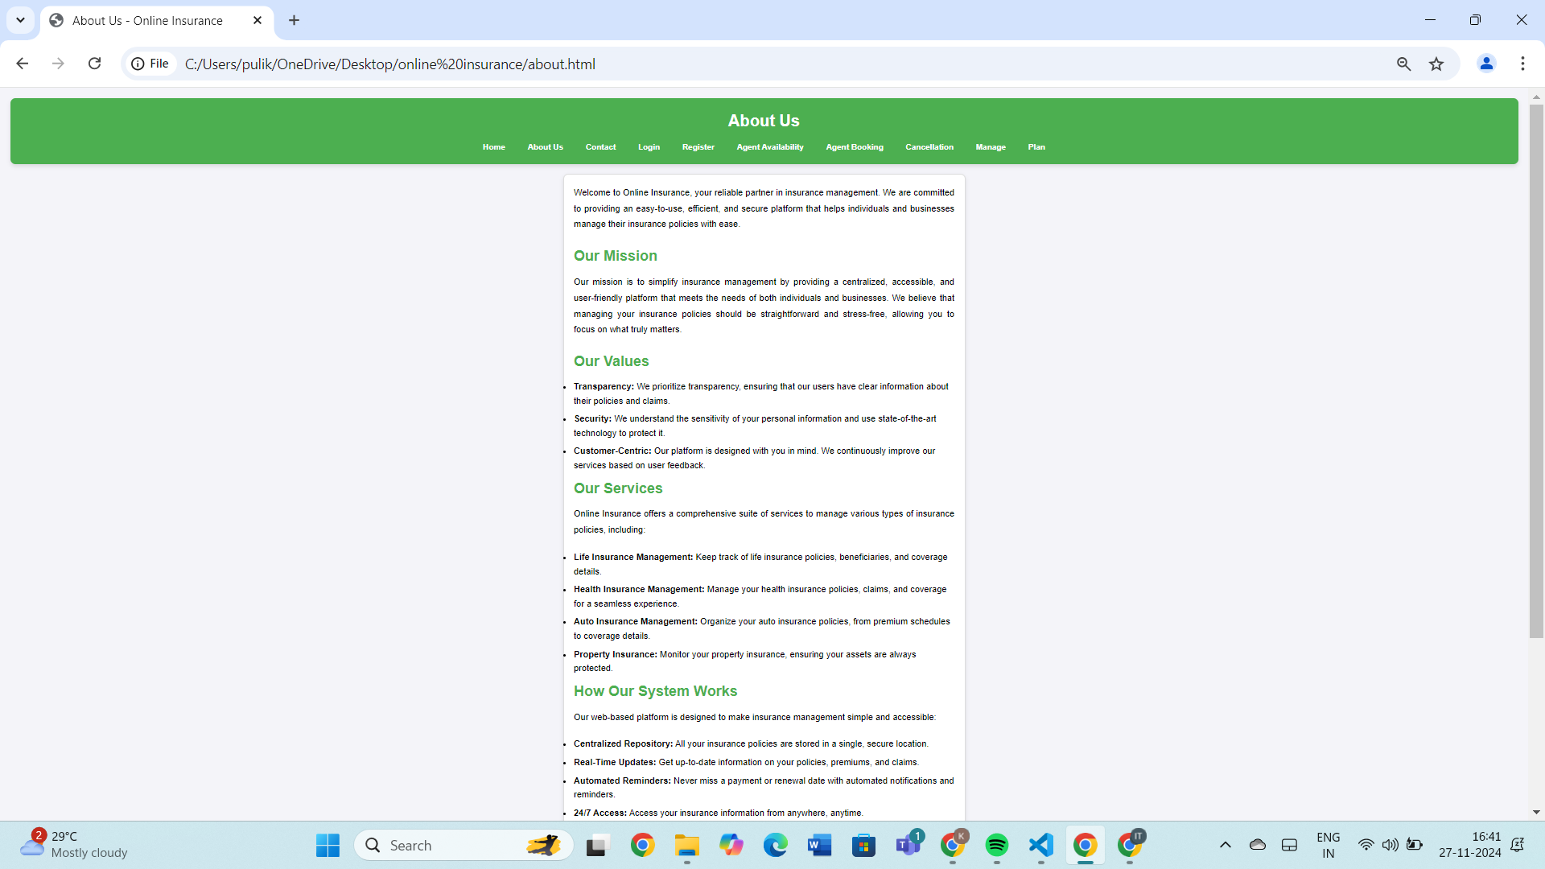
ABOUT US PAGE:
This page tells about the website,
missions, values,
services and how the system works

Slide 12
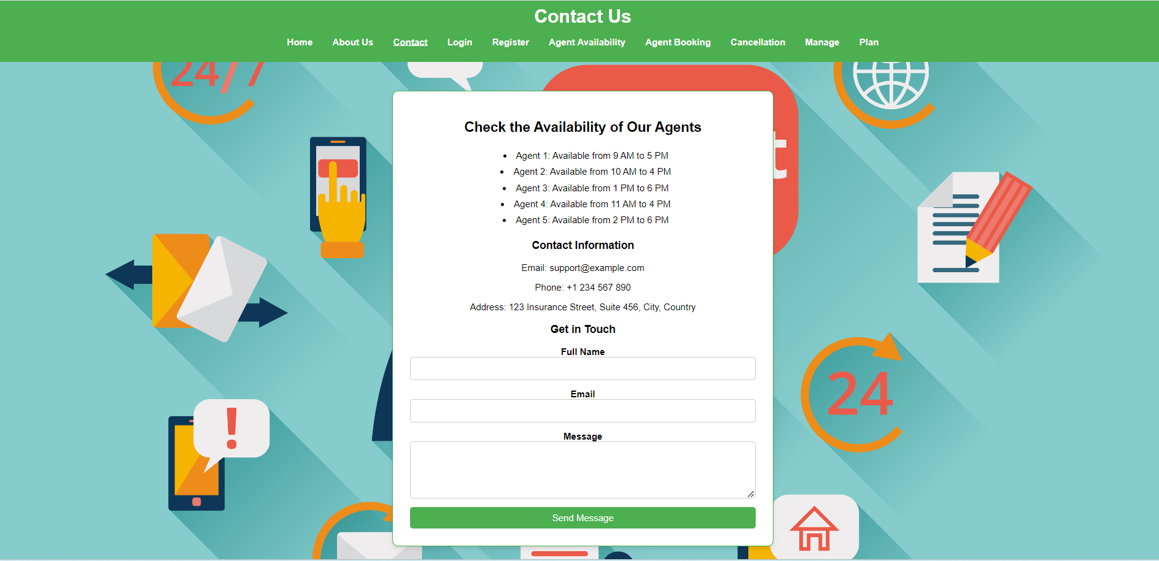
CONTACT PAGE
There is a dedicated contact page for user for contacting the agents

Slide 13
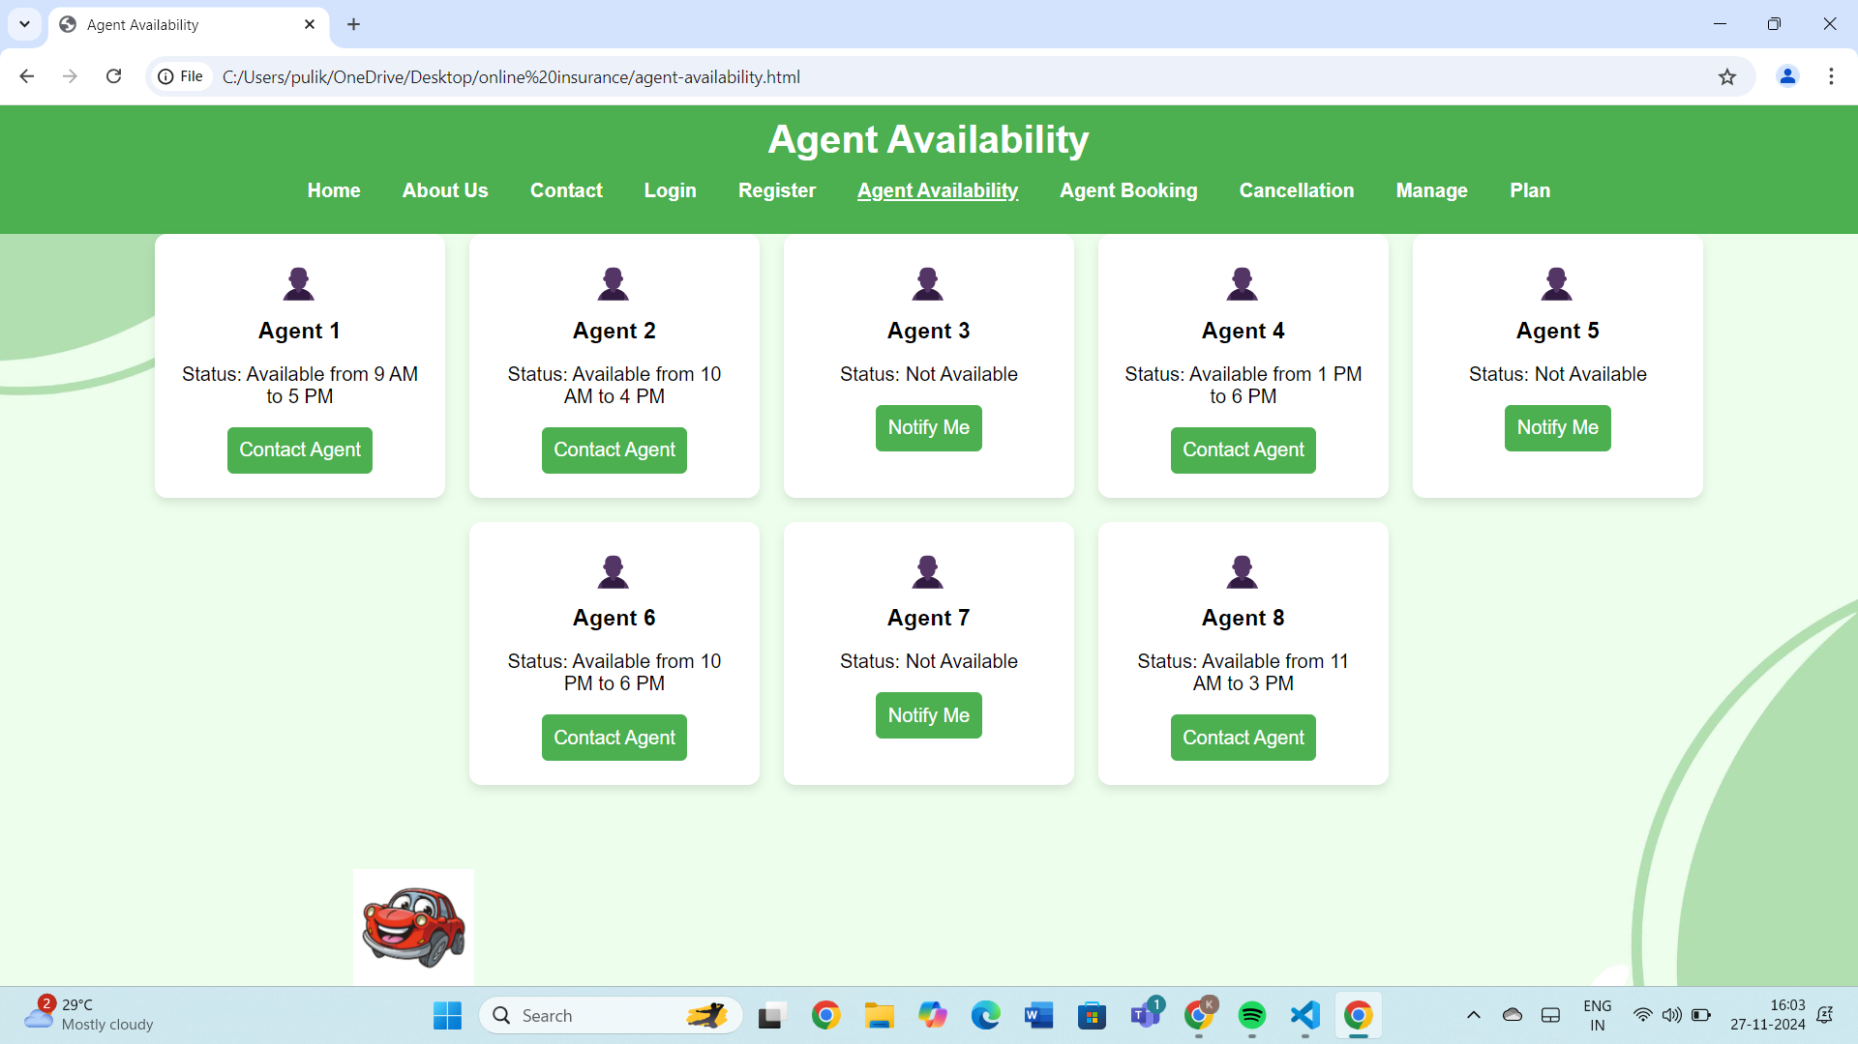
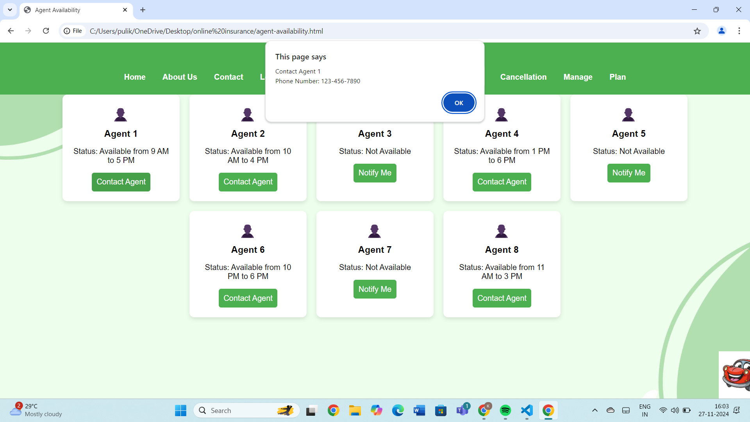
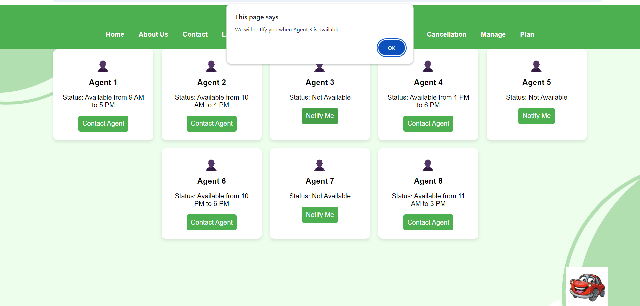
AGENT AVAILABLITY
User can check out for availability of agents if they are available user can contact them.
If they are not available they can click on NOTIFY button.

Slide 14
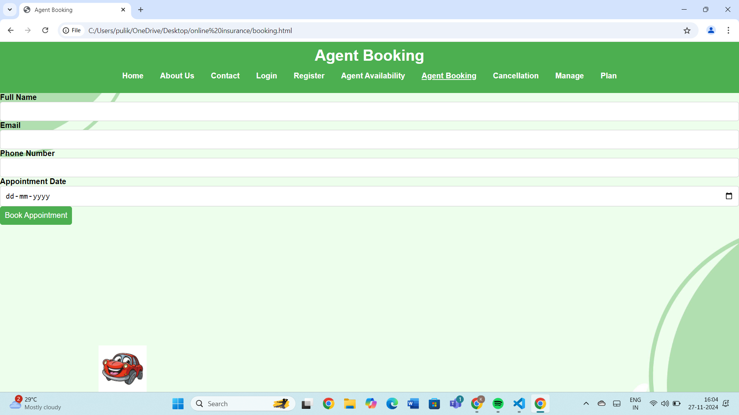
AGENT BOOKING
User can Book an Agent by our Booking Agent page .
By providing name , email , phone number and the date we booked the appointment

Slide 15
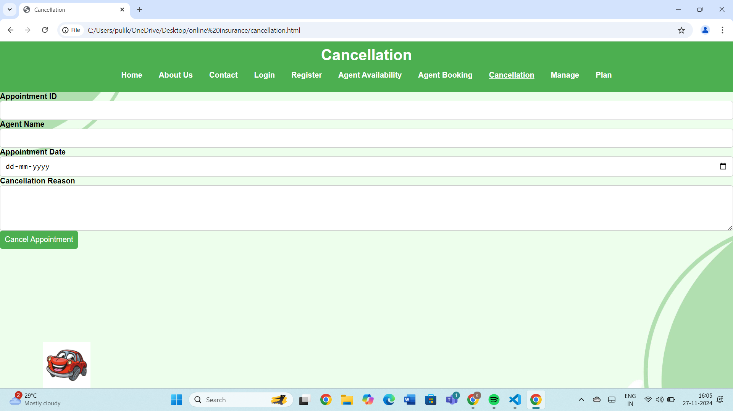
AGENT CANCELLATION
User can CANCEL there booking with an Agent by our cancellation page.
You need to provide appointment id,agent name and appointment date and reason for cancellation

Slide 16
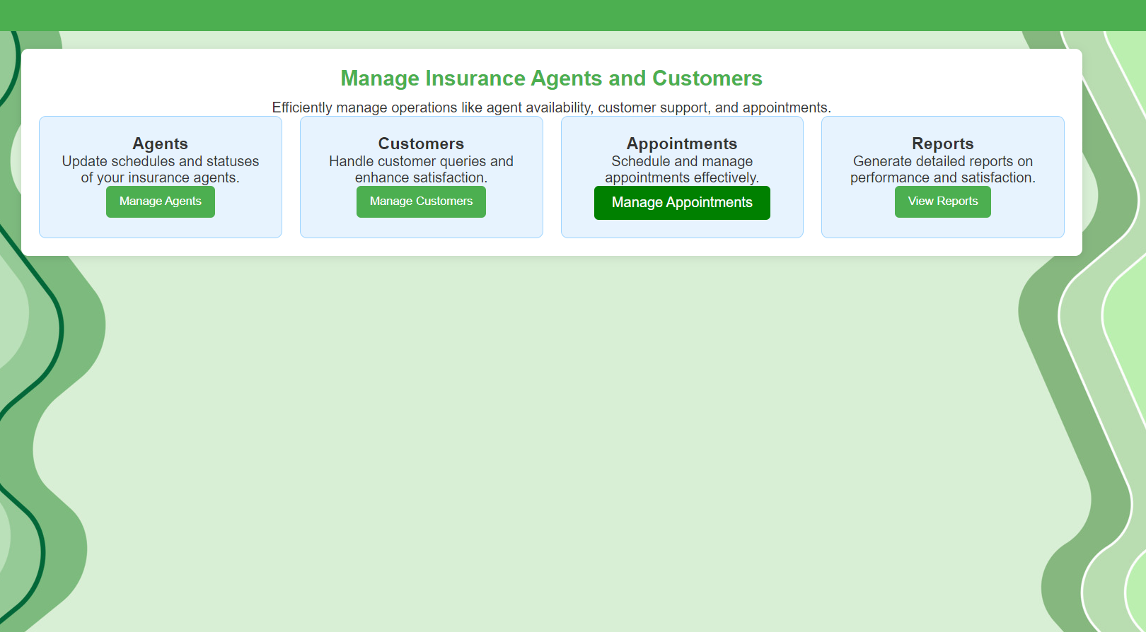
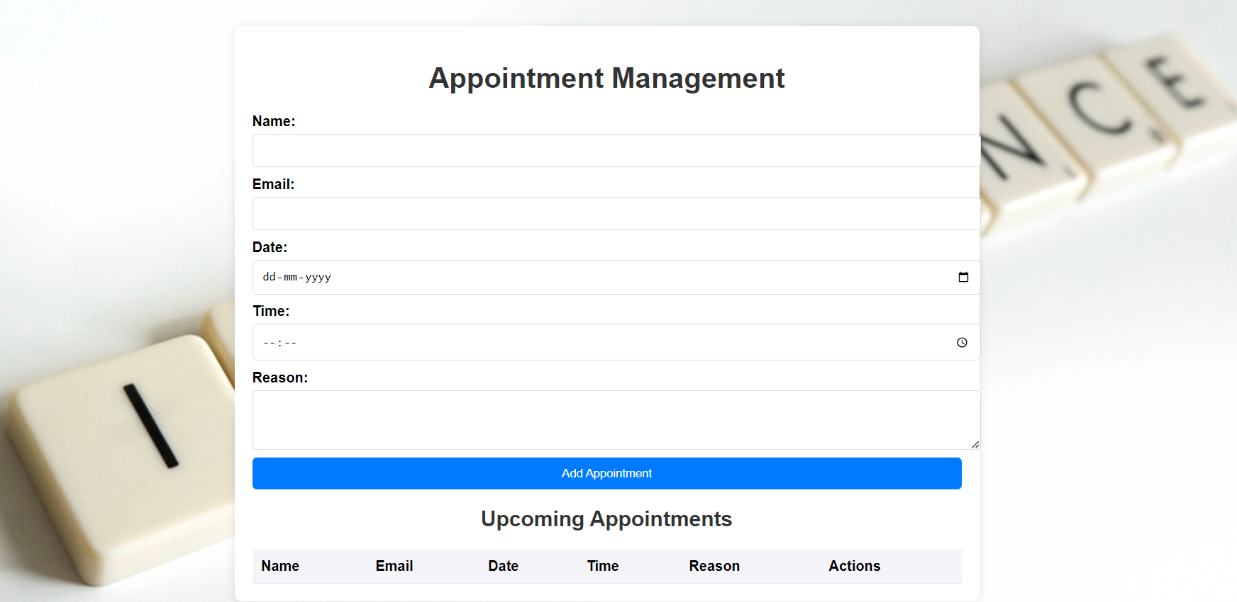
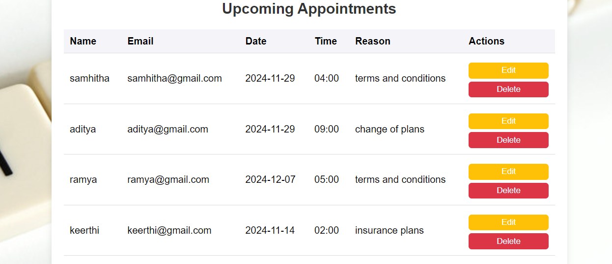

APPOINTMENT MANAGEMENT

Slide 17
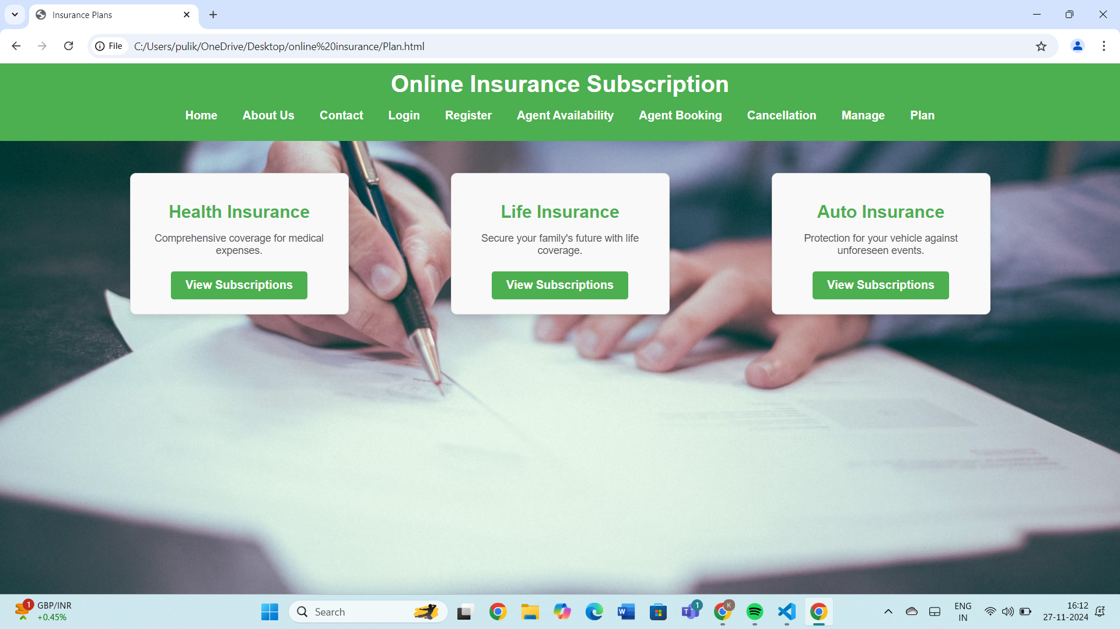
PLAN MANAGEMENT
This is the PLAN management page , where the user have different type of Insurance Plan are available.

Slide 18
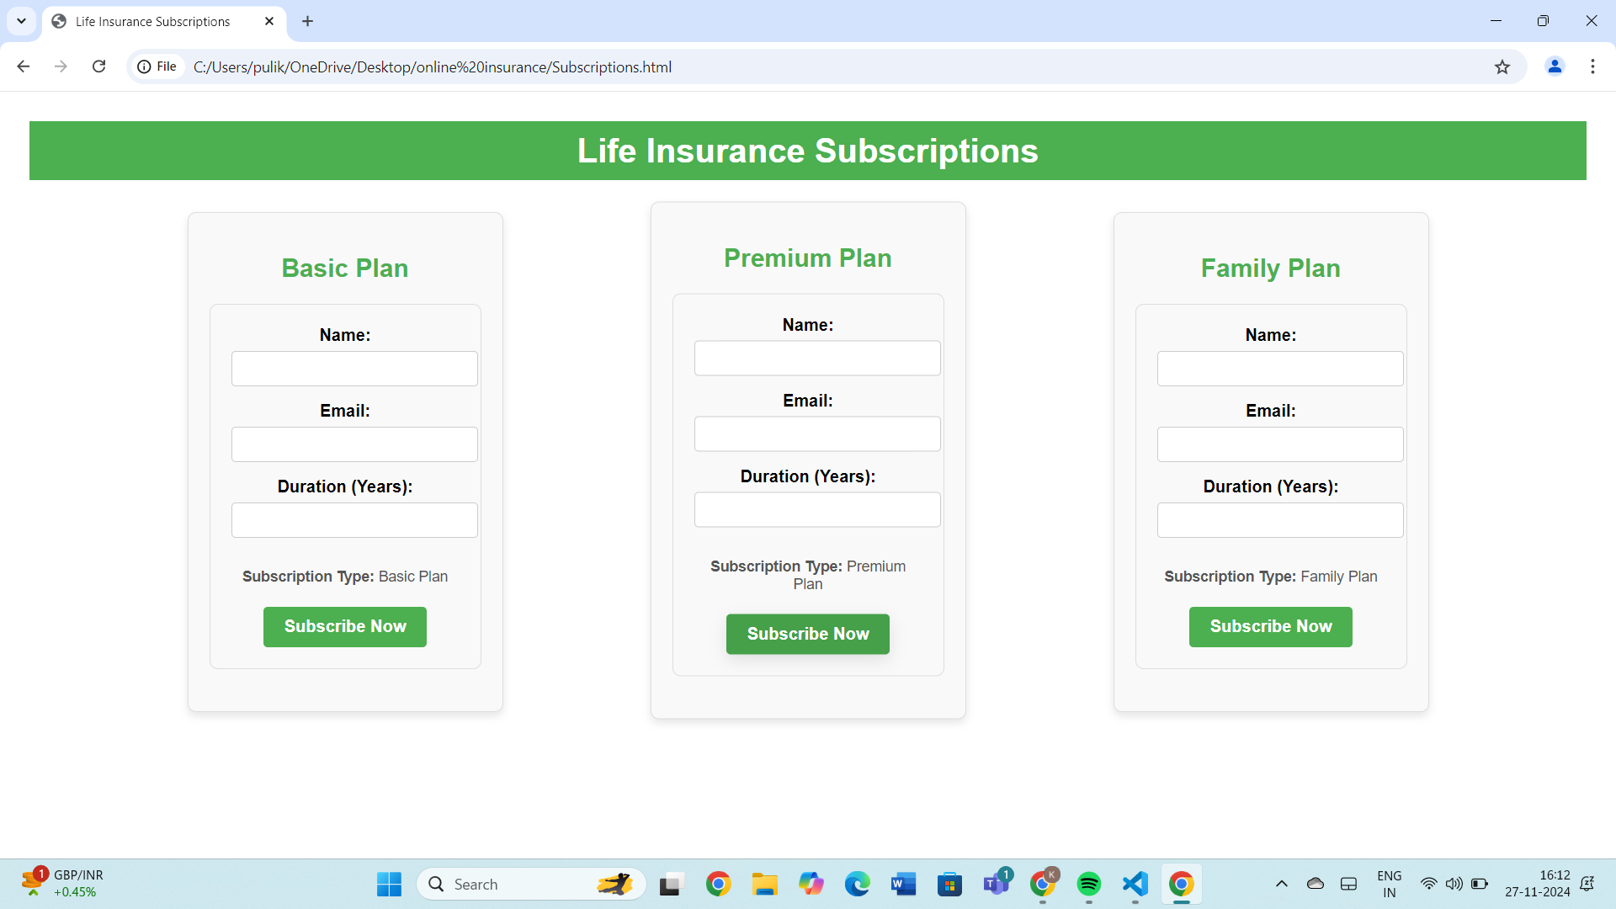
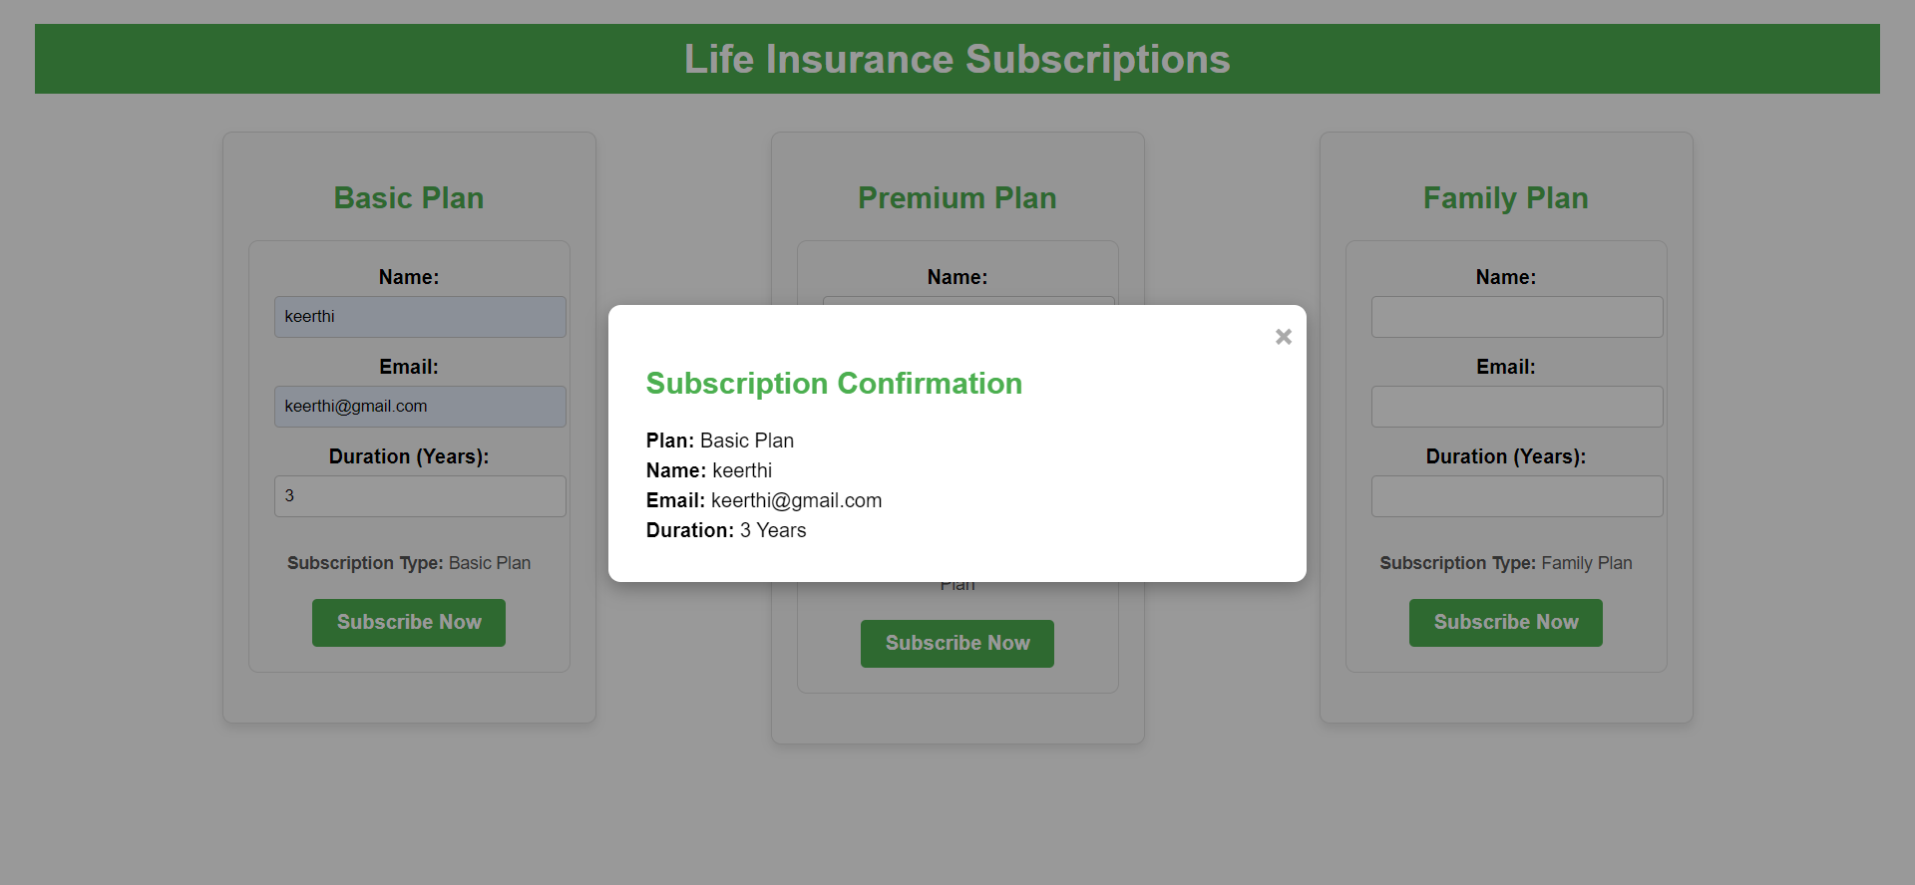
SUBSCRIPTION
In the subscription page 3 types of subscription option available for users.
After filling out the there details and clicking on subscribe now they will get confirmation Notification of there plan

Slide 19
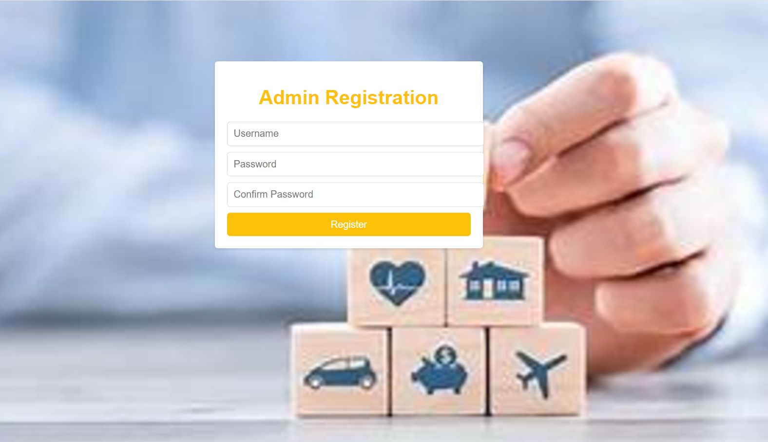
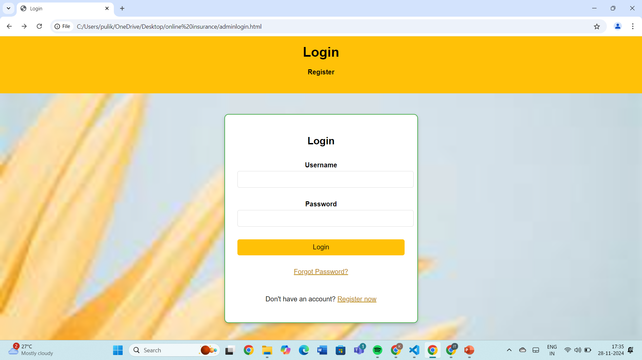
ADMIN REGISTRATION
This is admin Registration page where they can register by giving there Username and password.
This is admin Login page where they can login by giving there Username and password.

Slide 20
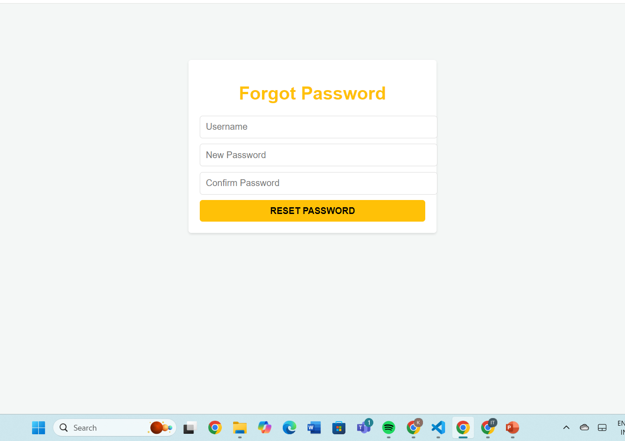
ADMIN PASSWORD RESET.
If ADMIN forgot there password they can reset it by using Forgot Password option.
Need to provide their username and the new password that they are resetting

Slide 21
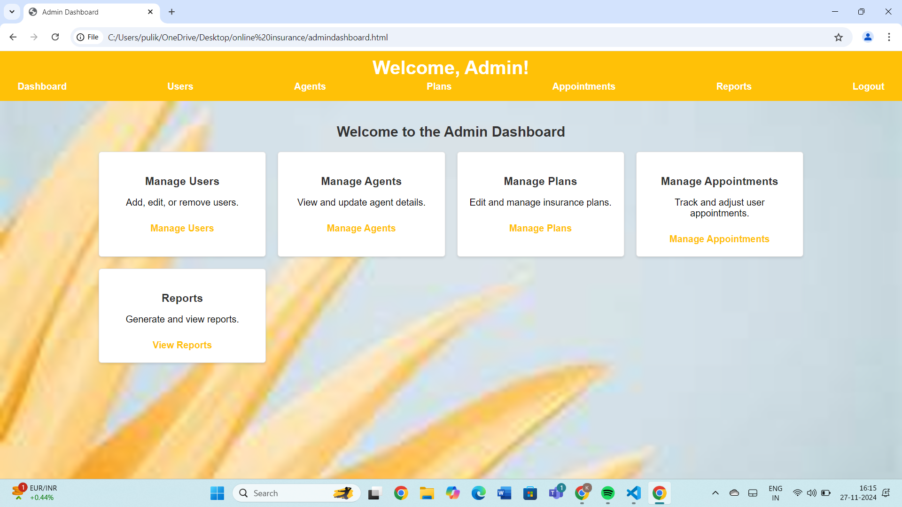
ADMIN DASHBOARD
This is the ADMIN welcome page , where different features are available.
Where admin can manage users, agents ,plans , appointments and can view reports

Slide 22

OUR TEAM
Puli Keerthi pavani venkata bhavani
Jupally Samhitha
Aditya Roy
Ramya D
MADDULURU SAI VIKAS

Slide 23

THANK YOU

